Slide 1

Huazhong University of Science and Technology
The Department of Electronics and Information Engineering
Electronic Circuit Analysis and Design
Dr. Tianping Deng
Email: dengtp@hust.edu.cn

Slide 2
Contents
PART 1 SEMICONDUCTOR DEVICES AND BASIC APPLICATIONS
Chapter 1 Semiconductor Materials and Diodes
Chapter 2 Diode Circuits
Chapter 3 The Field-Effect Transistor
Chapter 4 Basic FET Amplifiers
Chapter 5 The Bipolar Junction Transistor
Chapter 6 Basic BJT Amplifiers
Chapter 7 Frequency Response
Chapter 8 Output Stages and Power Amplifiers
PART 2 ANALOG ELECTRONICS
Chapter 9 Ideal Operational Amplifiers and Op-Amp Circuits
Chapter 10 Integrated Circuit Biasing and Active Loads
Chapter 11 Differential and Multistage Amplifiers
Chapter 12 Feedback and Stability
Chapter 13 Operational Amplifier Circuits
Chapter 14 Nonideal Effects in Operational Amplifier Circuits
Chapter 15 Applications and Design of Integrated Circuits
Chapter 2 Diode Circuits

Slide 3
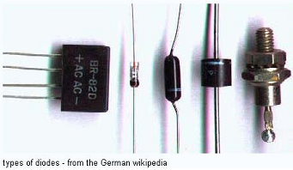
Ch2. Diode Circuits
2.1 Rectifier Circuits
2.2 Zener Diode Circuits
2.3 Clipper and Clamper Circuits
2.4 Multiple-Diode Circuits
2.5 Photodiode and LED Circuits
2.6 Design Application: DC Power Supply
2.7 Summary

Slide 4
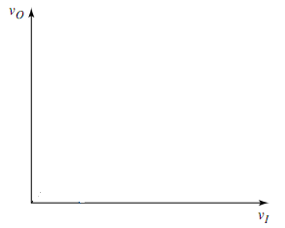
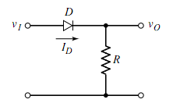
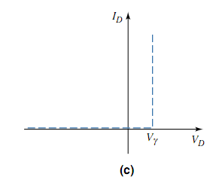
2.4 Multiple-Diode Circuits
2.4.1 Example Diode Circuits
Plot voltage transfer characteristics
Ideal model

Slide 5
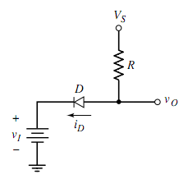
2.4 Multiple-Diode Circuits
2.4.1 Example Diode Circuits
Plot voltage transfer characteristics
ON
OFF

Slide 6
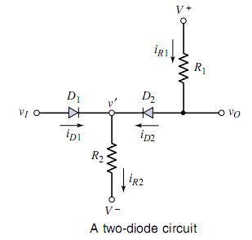
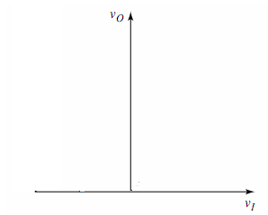





2.4 Multiple-Diode Circuits
2.4.1 Example Diode Circuits
×
ON
Plot voltage transfer characteristics

Slide 7


2.4 Multiple-Diode Circuits
2.4.1 Example Diode Circuits

Slide 8
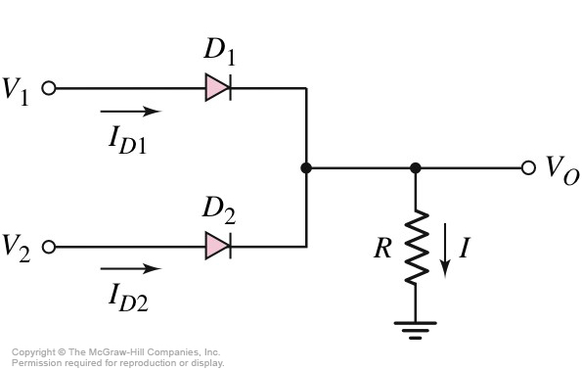
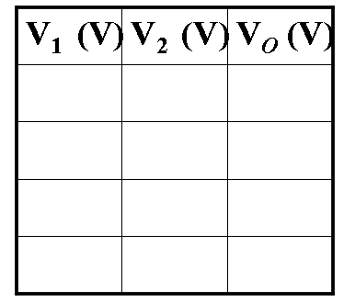

2.4 Multiple-Diode Circuits
2.4.2 Diode Logic Circuits
V_{γ} = 0.7V
what is the logic?
2-Input OR Gate

Slide 9
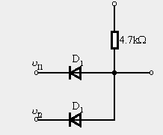
2.4 Multiple-Diode Circuits
2.4.2 Diode Logic Circuits
+5V
Assume the diode is ideal.
Think about.
what is the logic?
v_{O}=？
and gate
input/V
D1
D2
output
0，0
on
on
0V
0，5
on
off
0V
5，0
off
on
0V
5，5
off
off
5V

Slide 10
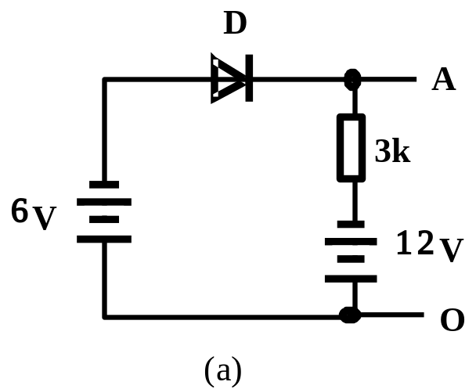


Example: Diode Circuits
Diode Circuit shown in figure (a), calculate the voltage between points A and O.
Sol: First, assume D is open circuit, and O is ground potential.
Anode voltage of D is –6V. Cathode voltage of D is –12V.
So, anode voltage is greater than cathode voltage.
When D is connected into the circuit, it is forward-biased, and “on” state.
U_{AO}=-6V

Slide 11
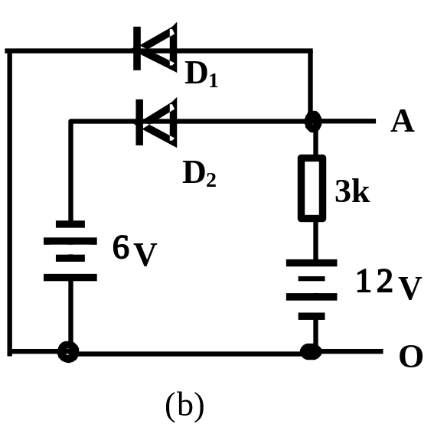
Example: Diode Circuits
2. Diode Circuit shown in figure (a), calculate the voltage between points A and O.
Sol: First, assume D1 and D2 are all open circuit, and O is ground potential.
Anode voltage of D1 is 12V,Cathode voltage of D1 is 0V.
Anode voltage of D2 is 12V,Cathode voltage of D2 is −6V.
D2 is on firstly. The potential of A is clipped to −6V. So, D1 is reverse-biased, and “off” state.

Slide 12
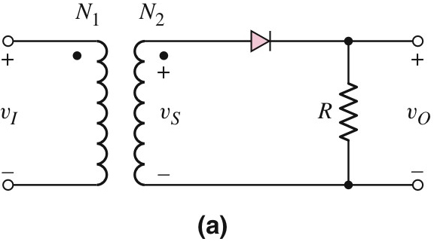
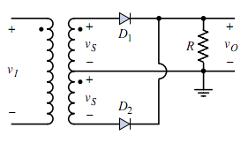
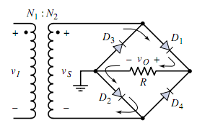
2.7 Summary
Rectifier

Slide 13
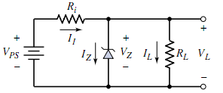
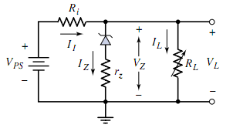
2.7 Summary
Zener Diode

Slide 14
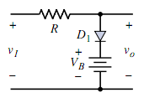
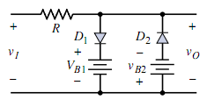
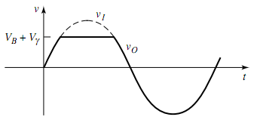
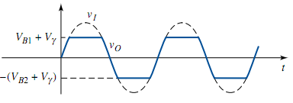
2.7 Summary
Clipper

Slide 15

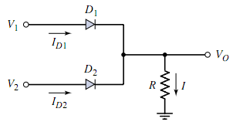
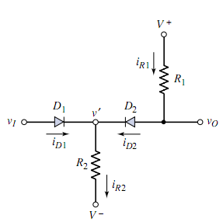
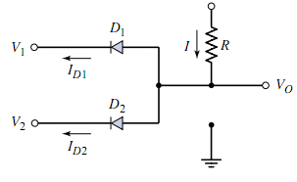
2.7 Summary

Slide 16
Homework：P113 2.14
Homework：P119 2.45

Slide 17
Questions
and
Answers

